Slide 1

24 Aug 2024
Infosys
Stock Price Prediction
Capstone Project - 2
Presented By
Nanditha JK

Slide 2
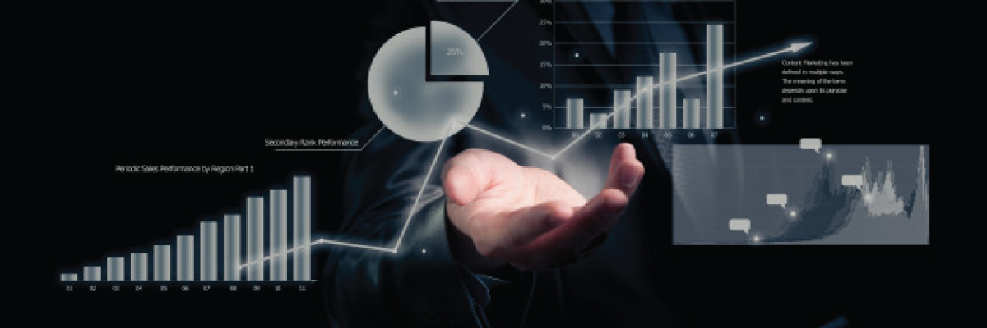
Contents
1 | Introduction
2 | Problem Statement
3 | Dataset
4 | Overview
5 | EDA
6 | Model Building
7 | Models Comparision
8 | Deployment
9 | Conclusion

Slide 3

INTRODUCTION
Since its inception in 1981, Infosys has been a key player in the global technology services and consulting sector. As a publicly traded company on the Indian Stock Exchange since 1996, Infosys's stock has witnessed significant growth, influenced by various market factors, industry trends, and global economic shifts.
Predicting the stock price of such a dynamic entity requires not only an understanding of historical data but also the application of advanced machine learning techniques.
In this presentation, we delve into the prediction of Infosys's stock prices using sophisticated time series models and machine learning algorithms. We start by exploring the historical data, beginning from 1996, to understand the trends and patterns that have shaped Infosys's stock performance over the years.

Slide 4
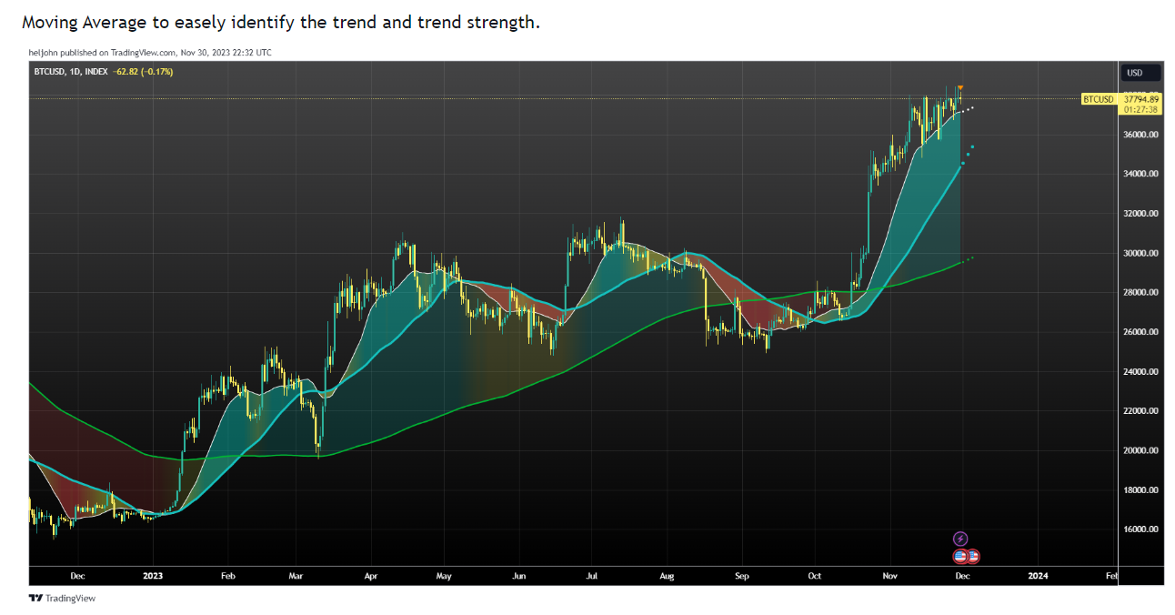
PROBLEM STATEMENT
Vision
Mission
In the volatile and rapidly changing stock market, accurately predicting stock prices is a significant challenge that investors, analysts, and financial institutions face daily.
For a company like Infosys, a global leader in IT services, reliable stock price predictions are crucial for making informed investment decisions, managing risks, and developing strategies for financial growth.
Traditional methods of stock price prediction often fall short in capturing the complex, non-linear patterns present in financial time series data.
Given the importance of accurate predictions in shaping investment strategies and understanding market behavior, this project aims to explore and implement advanced machine learning models, including ARIMA, Auto ARIMA, XGBoost, Linear Regression, LSTM, and GRU, to enhance the accuracy and reliability of Infosys stock price predictions.
By leveraging historical data starting from 1996, the project seeks to provide deeper insights into the factors influencing stock prices and to develop a robust predictive model that can assist stakeholders in making more informed decisions.

Slide 5

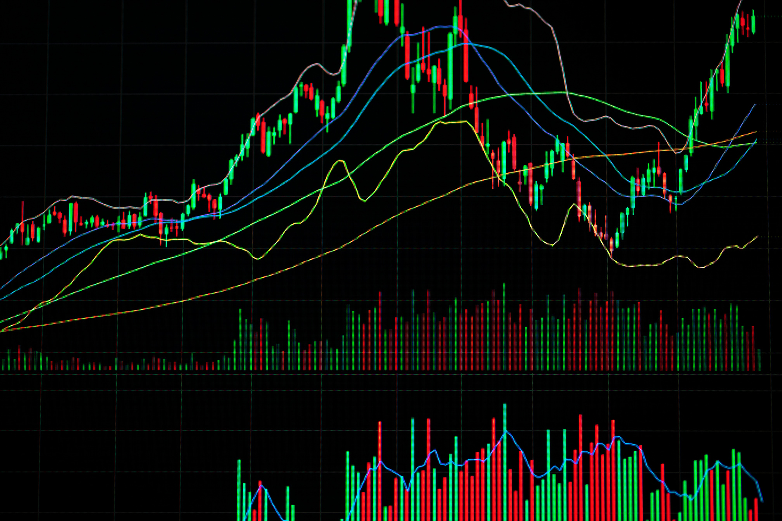
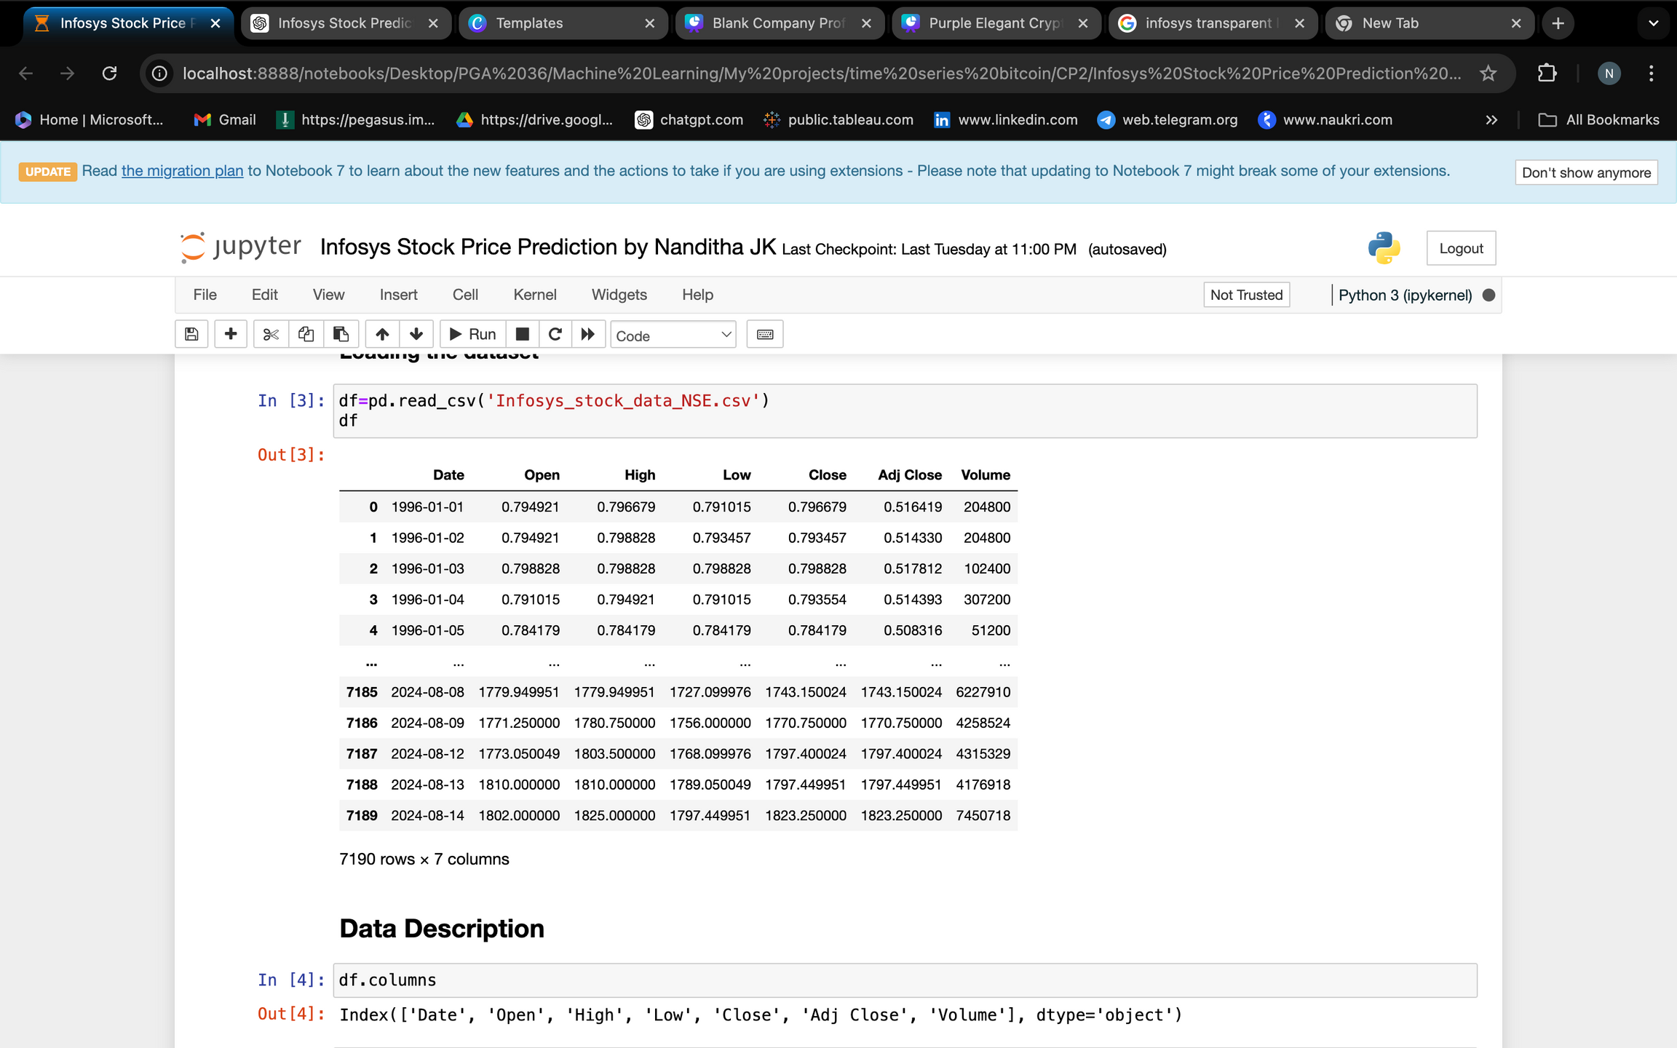
DATASET
The dataset used for this analysis was sourced from Yahoo Finance, utilizing the yfinance module to facilitate data extraction.
It encompasses historical stock price data from January 1, 1996, through August 14, 2024, providing a comprehensive view of nearly three decades of market activity.
This extensive dataset includes 7,190 records, offering a rich foundation for time series analysis and predictive modeling.
Features: The dataset includes 7 features
Date: The specific date of the trading data.
Open: The price of the stock at the beginning of the trading day.
High: The highest price the stock reached during the trading day.
Low: The lowest price the stock reached during the trading day.
Close: Target variable; represents the closing price of the stock, and it's continuous.
Adj Close: The closing price adjusted for corporate actions like dividends, stock splits, etc.
Volume: The number of shares traded during the day.

Slide 6
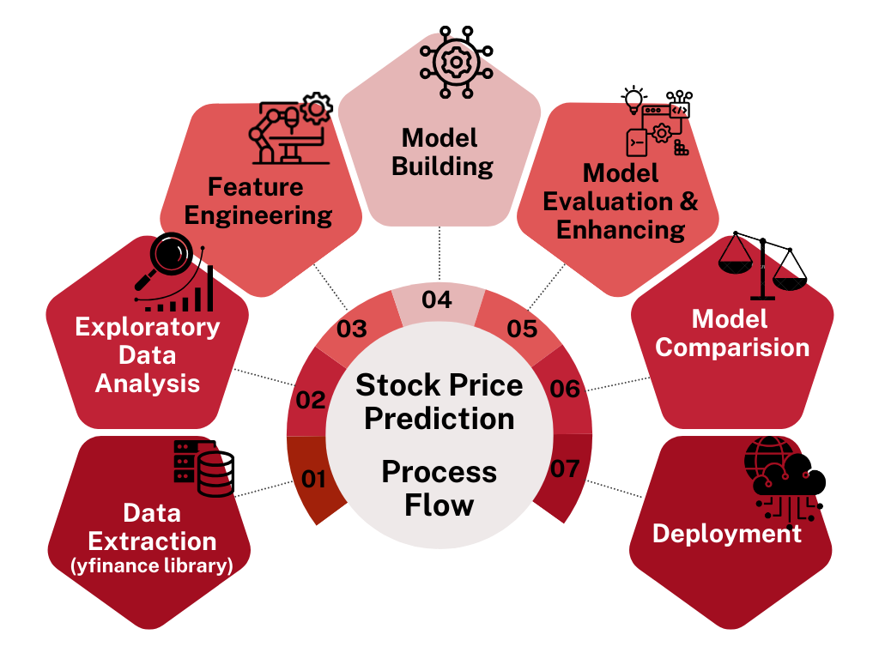
Overview

Slide 7
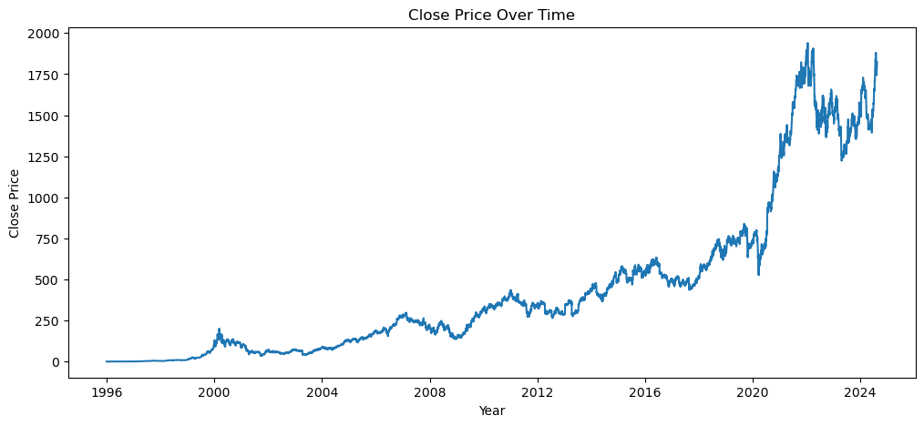
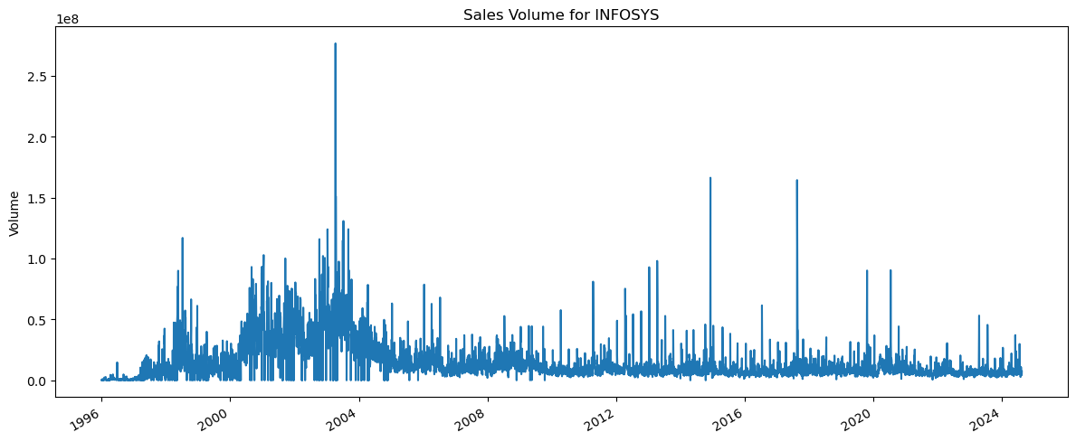
Exploratory Data Analysis
Plot illustrates the gradual increase in stock closing prices from 1996 to 2024, with a significant upward acceleration post-2020
Plot shows stock volume peaking between 2000 and 2004, followed by a gradual decline over time
Back to Agenda

Slide 8
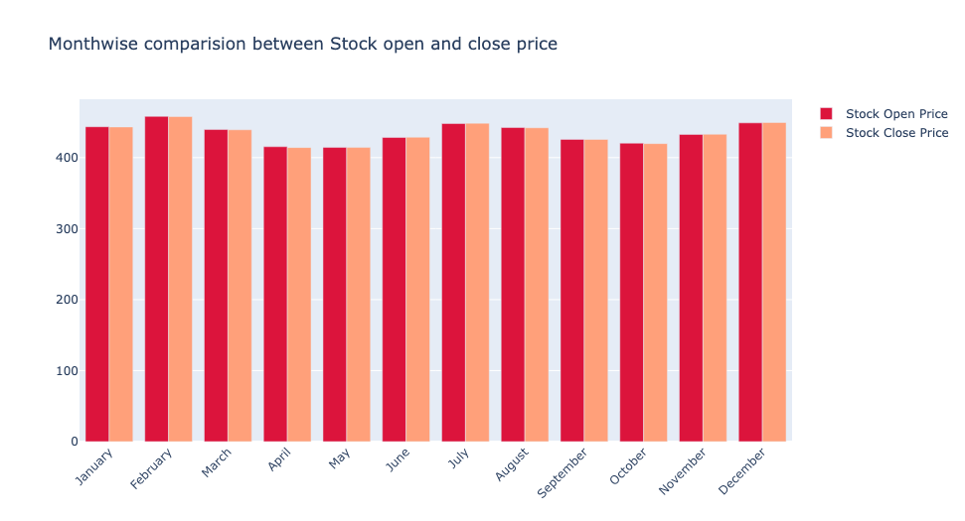
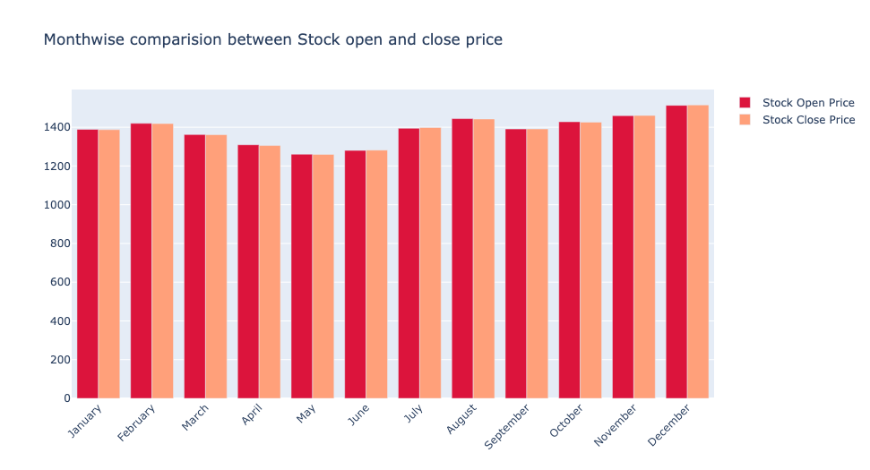
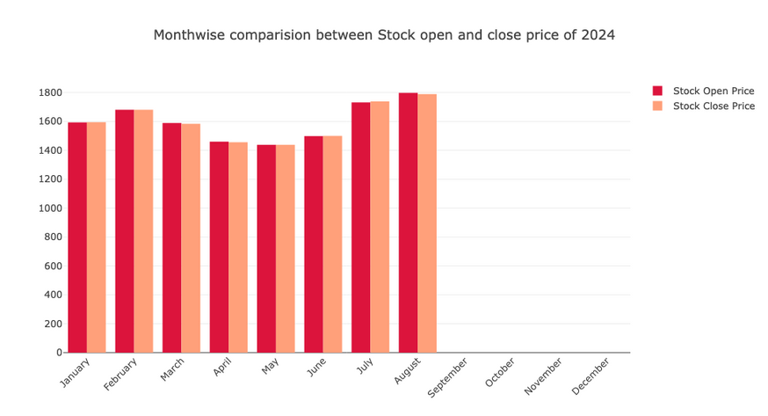
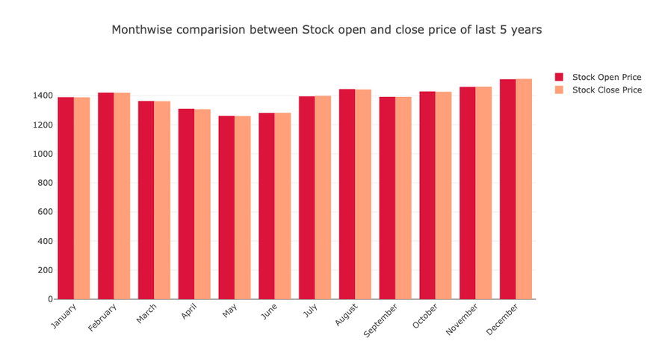
Monthwise comparision b/w Stock Open and Close price
Comparison of stock open and close prices reveals that February shows an increase, followed by a gradual decrease from March.
A rise is observed in July and August, with a slow decline thereafter. November and December exhibit another significant increase.
This pattern is consistent across all data, the last 5 years, and the 2024 data
This recurring pattern in Infosys stock prices suggests seasonal influences and potential cyclical trends in the market.
The consistent behavior across different time periods indicates that these patterns may be driven by broader market or company-specific factors, such as quarterly earnings reports or annual financial cycles.
Back to Agenda

Slide 9
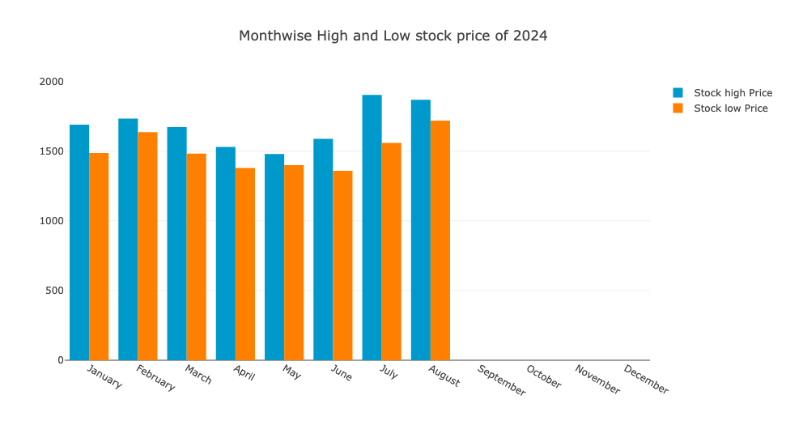
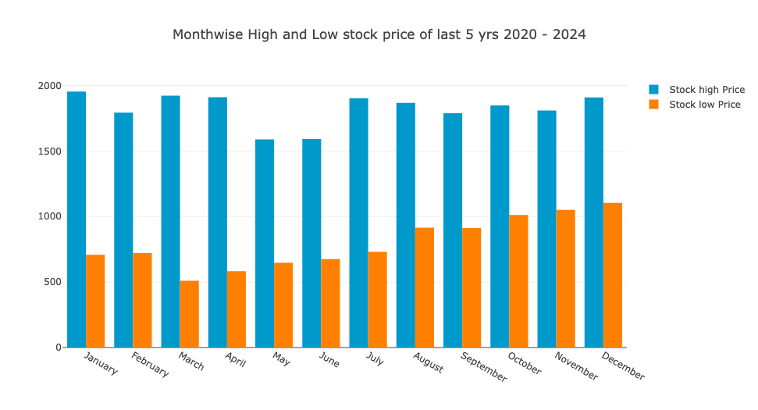
Monthwise comparision b/w High and Low Price
The consistent monthly pattern across years and in 2024 highlights recurring seasonal trends. The reduced difference between high and low prices in 2024 suggests lower volatility and potentially more stable market conditions compared to the past five years.
In 2024, the stock exhibits the same monthly pattern of increases and decreases. However, the difference between high and low prices is less pronounced compared to previous years, indicating a narrower range of price fluctuations.
Back to Agenda

Slide 10
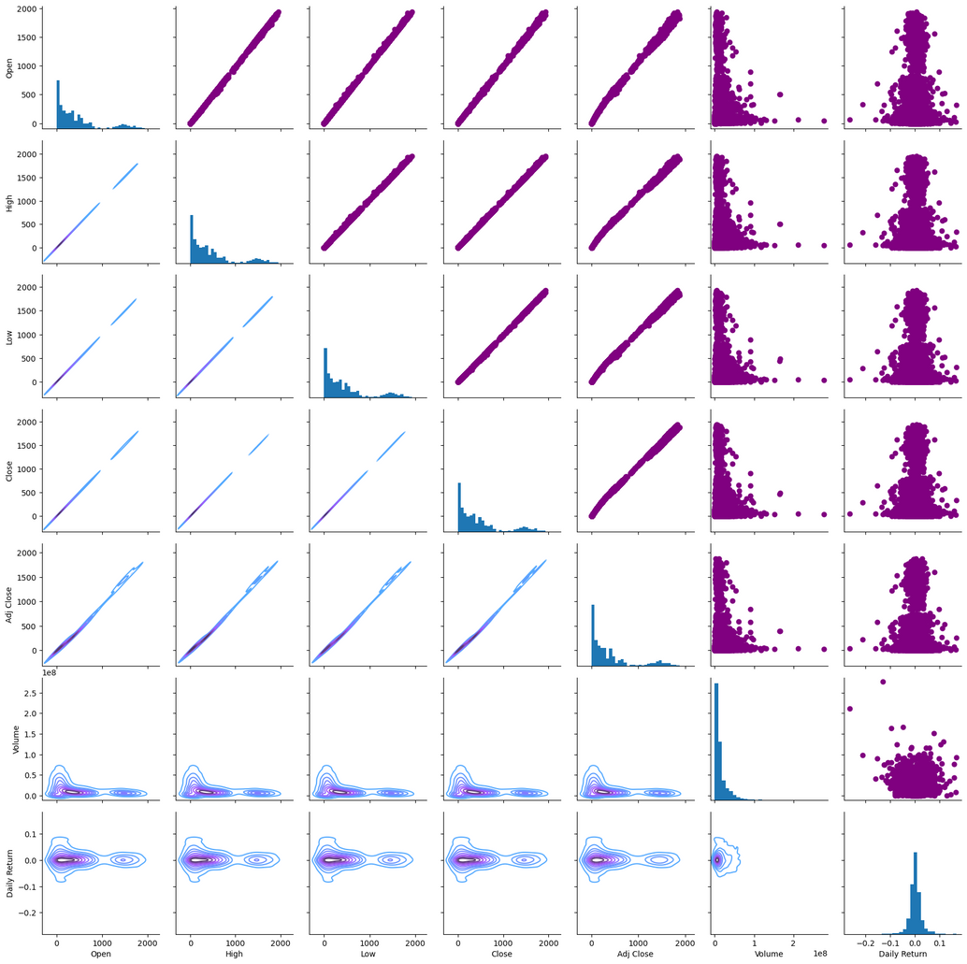
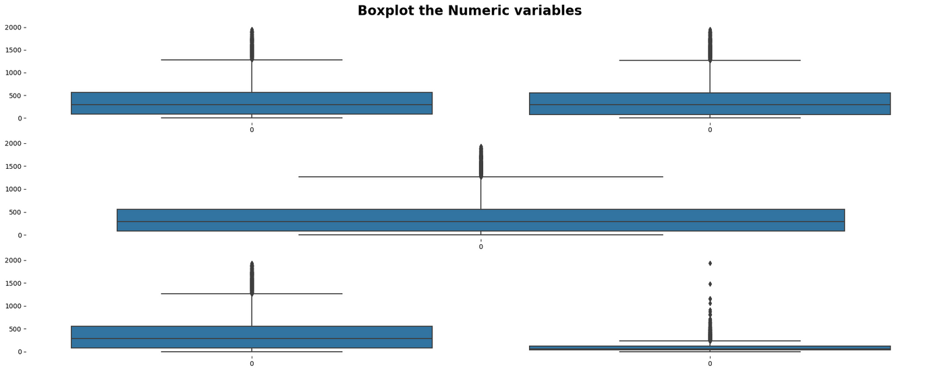
Exploratory Data Analysis
Pair plot of all features reveals linear relationships, suggesting that linear regression may be effective for modeling.
Boxplot shows all numeric features contain outliers; however, these outliers are intrinsic to stock data patterns and cannot be removed, as they often represent significant market events or anomalies
Back to Agenda

Slide 11

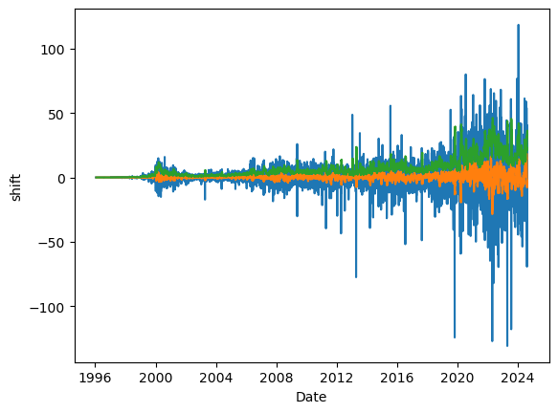
Data Pre-processing
Stationary
Data Preparation
Feature Scaling
Checking the data stationary using moving average and ADF test and making data statioanary using transformation (shift and differencing) method
Selecting only 1 year (244 records) of data for model building except (arima and auto arima)
Using MinMax scaler for bringing all data into same scale.
Dataset Matrix
Converting dataset into matrix for time series analysis
Back to Agenda

Slide 12
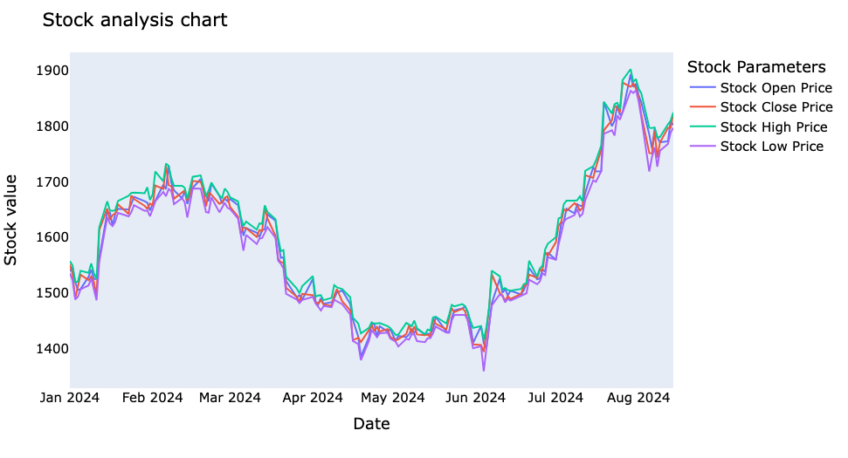
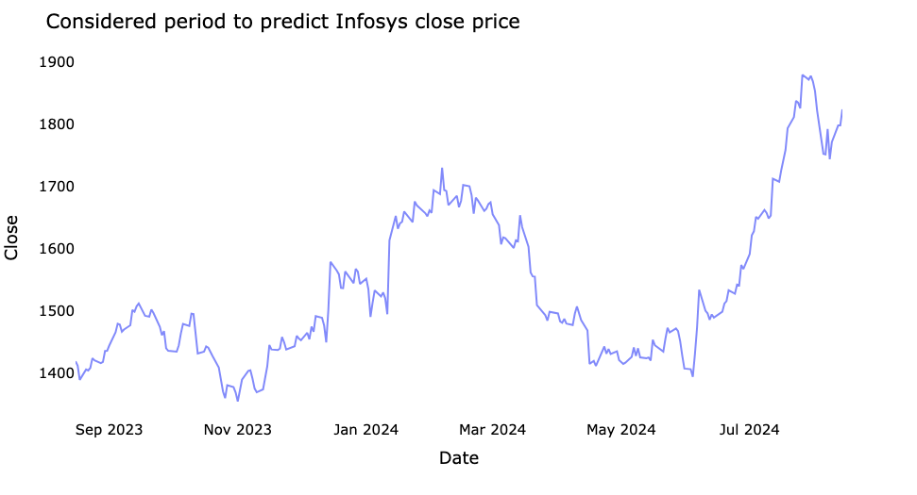
Considered period of data for prediction
We observed distinct variations in the stock's open, close, high, and low prices due to the limited dataset (1 year).
To enhance prediction accuracy, we utilized data from August 2023 to August 2024, comprising 244 records.
This dataset was split into training and test subsets for model fitting and prediction.
Using a focused one-year dataset allows for capturing recent market trends and improving prediction accuracy, despite the observed variations due to the shorter data period
Back to Agenda

Slide 13
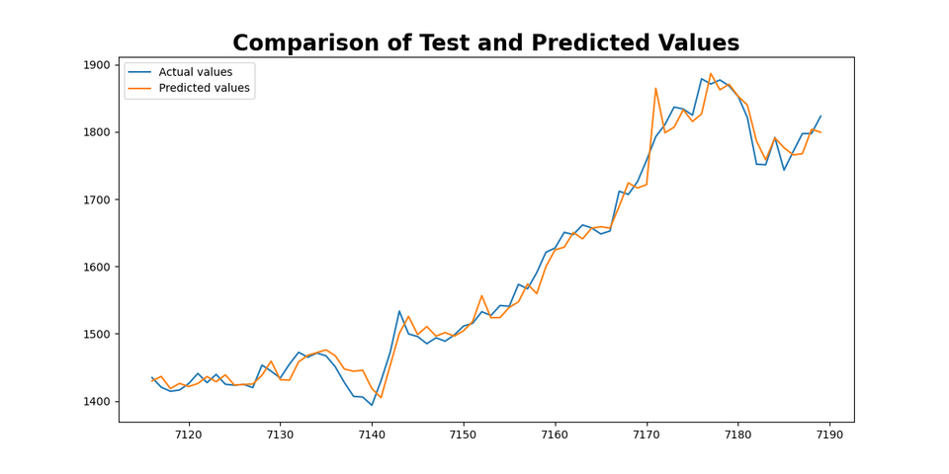
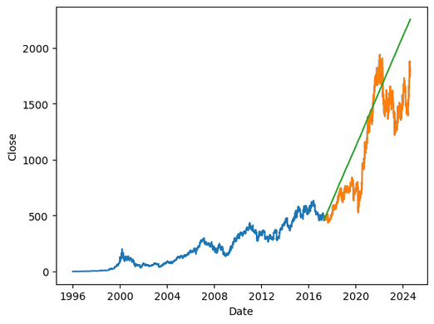
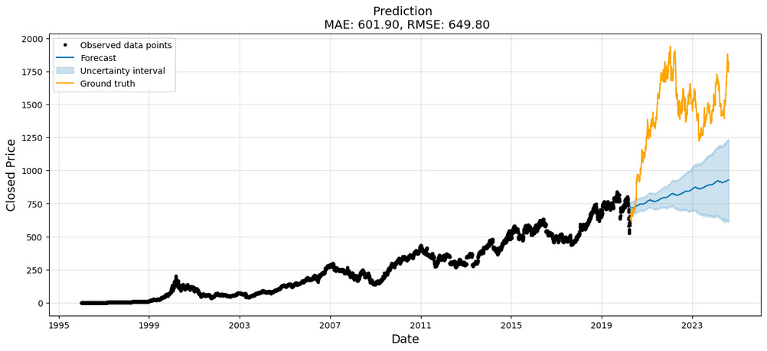
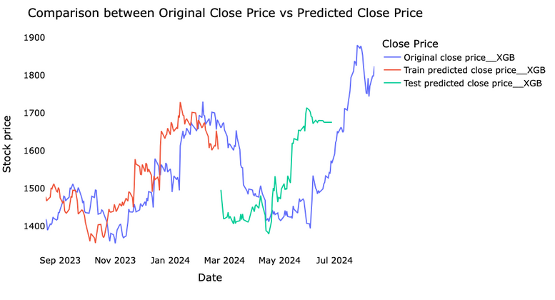
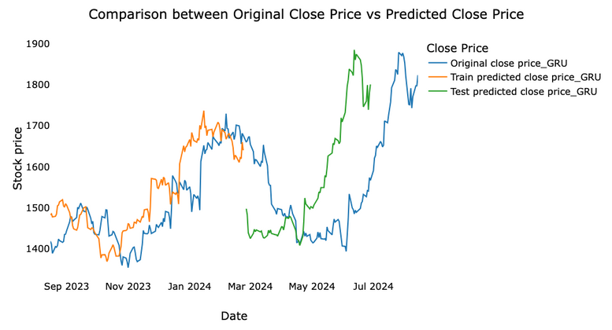
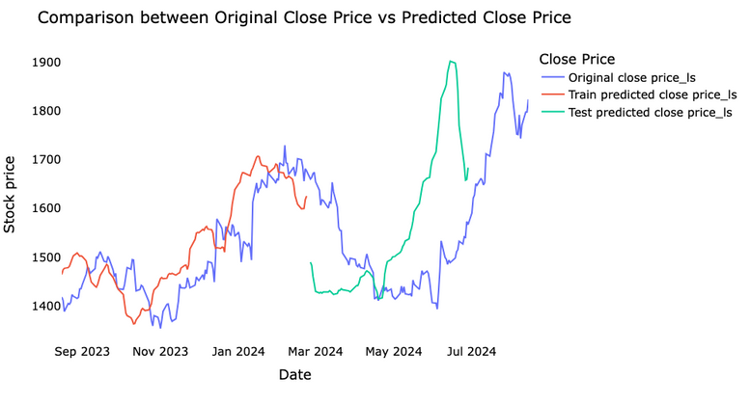
Comparision of Closing Price and Prediction of each model
ARIMA & Auto ARIMA
Linear Regression
Prophet
XG - Boost
GRU
LSTM
Back to Agenda

Slide 14
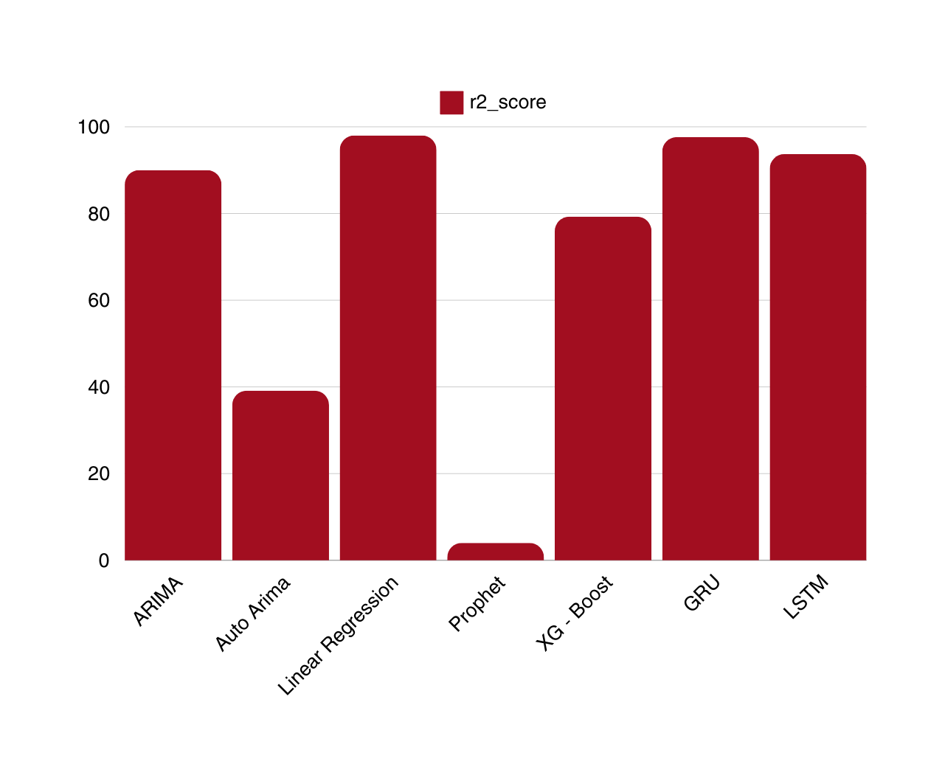
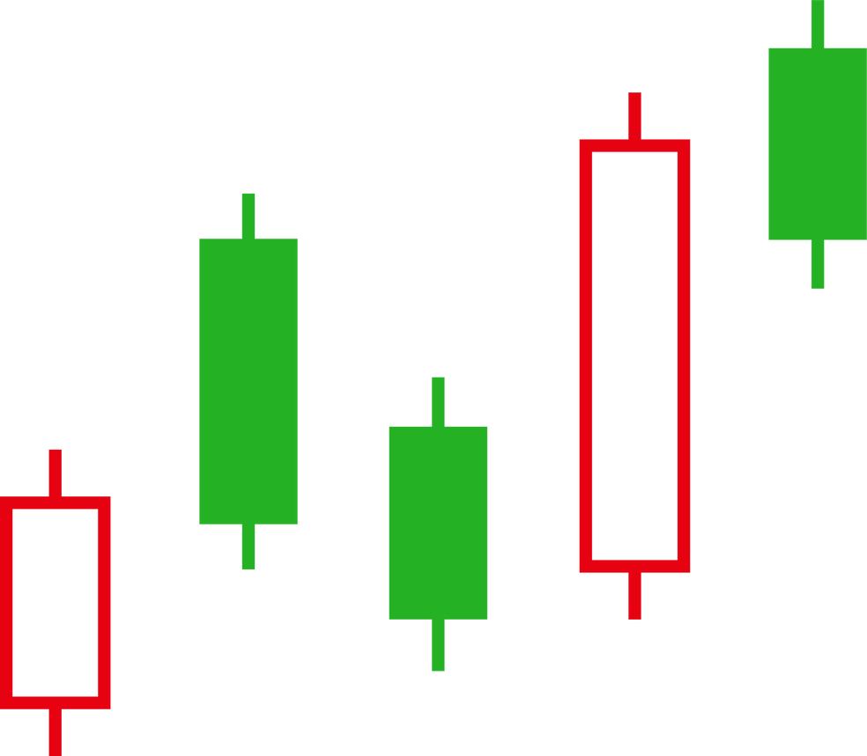
Model Comparision
By comparing with all the Algorithms GRU (Gated Recurrent Unit) is giving the highest accuracy (98.6%)

Slide 15


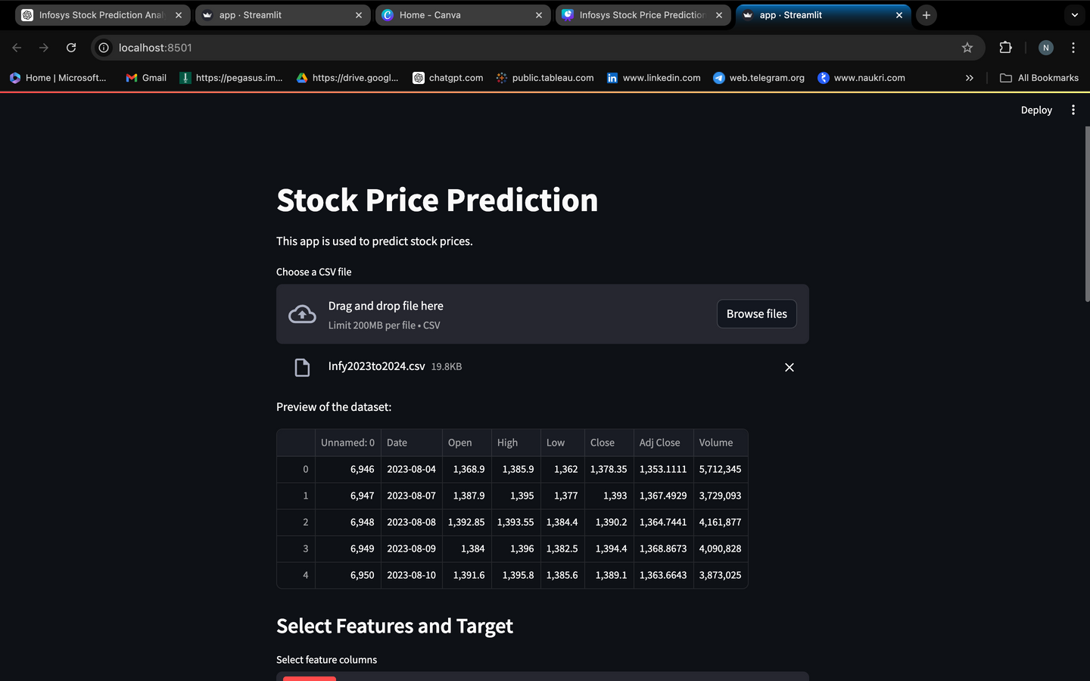
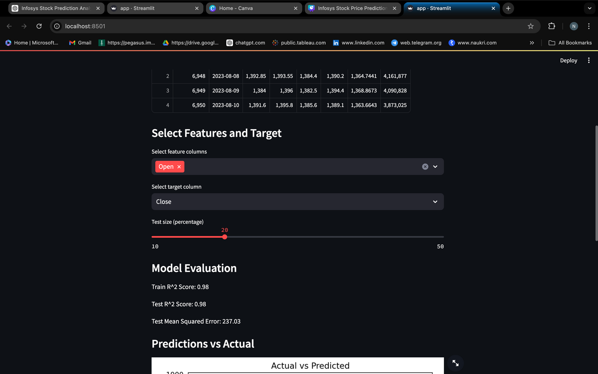
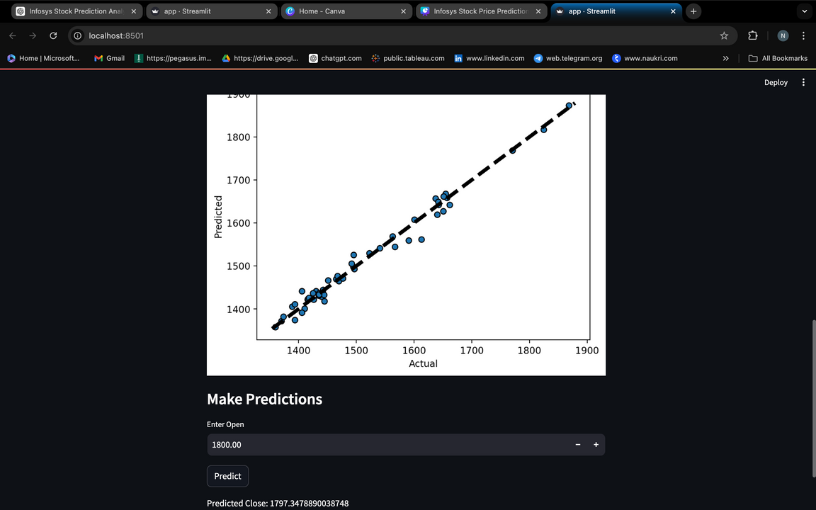
Deployment

Slide 16
Conclusion
Enhanced Accuracy: Machine and deep learning models, including LSTM, GRU, Linear Regression, and ARIMA, significantly improve stock price prediction accuracy, leading to better investment decisions.
Strategic Insights: These models offer deep insights into market trends and patterns, facilitating more informed trading strategies and financial planning.
Algorithmic Trading: Integrate predictive models into trading systems for automated, real-time market responses, optimizing profit and minimizing risks.
Portfolio Management: Utilize accurate forecasts to balance risk and reward, ensuring optimal asset allocation and improved portfolio performance.
Risk Management: Forecast market volatility and perform stress testing to manage investment risks effectively, enhancing financial stability.
Sentiment Analysis: Analyze market sentiment from news and social media using NLP to inform trading decisions and predict market movements.

Slide 17

Thank You
Name
Nanditha JK
email.id
nandithajkj1999@gmail.com

